Slide 1
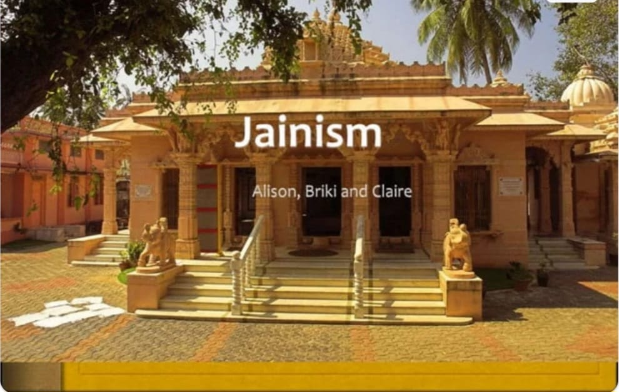

Slide 2
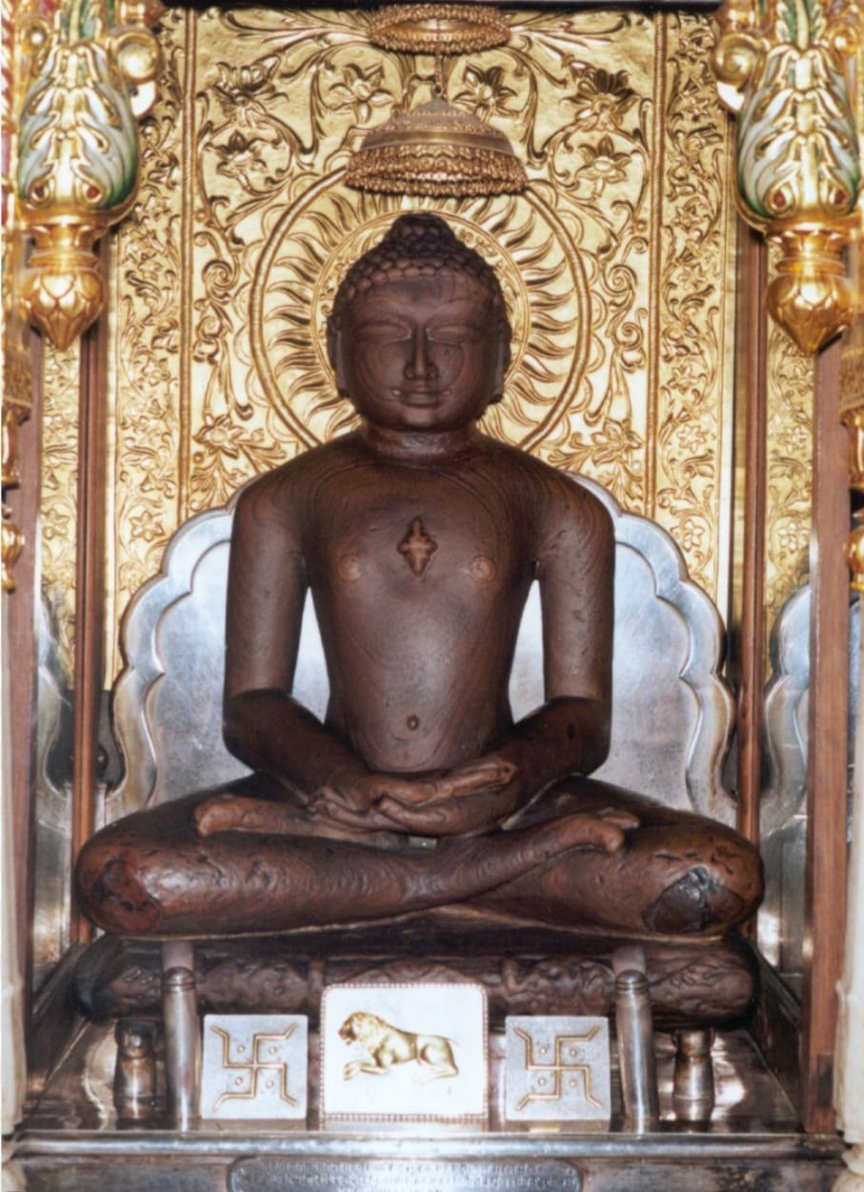
The Beginning
The history of Jainism Can be traced back through 24 Jinas
The first Jina was supposed to be a giant who lived 8.4 million years ago
Recent and last jina was vardhamana,who was born 540 BCE.

Slide 3
Vardhamana
Also Known as Mahavira (“Great Hero”)
Mother name: Trishala
Father name: Siddhartha
Spouse :Yasoda
Children :Priyadarsana
Age: 72 years
Symbol :Lion

Slide 4
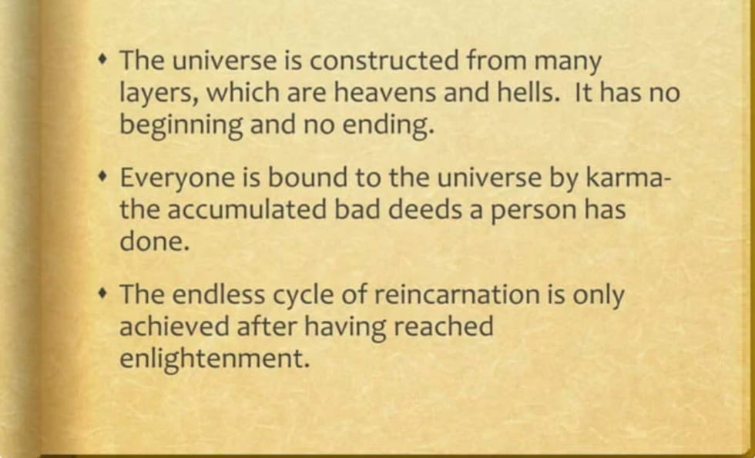
Basic Belief

Slide 5
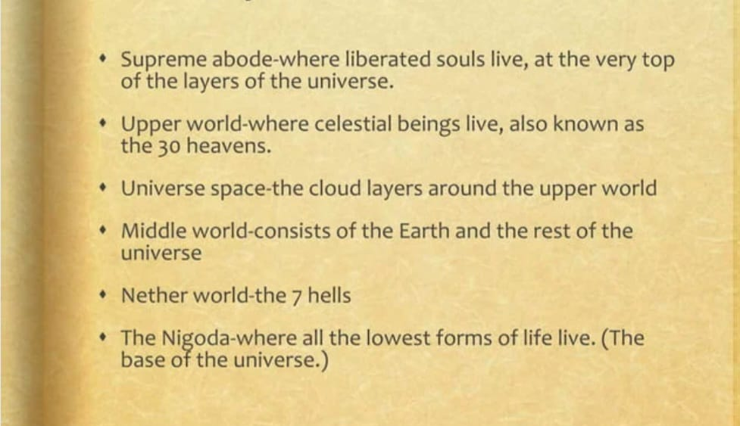
The Layers of the Universe

Slide 6
The 3 Basic Principles ,or
The 3 Ratnas
Right Faith
Right Knowledge
Right Action

Slide 7
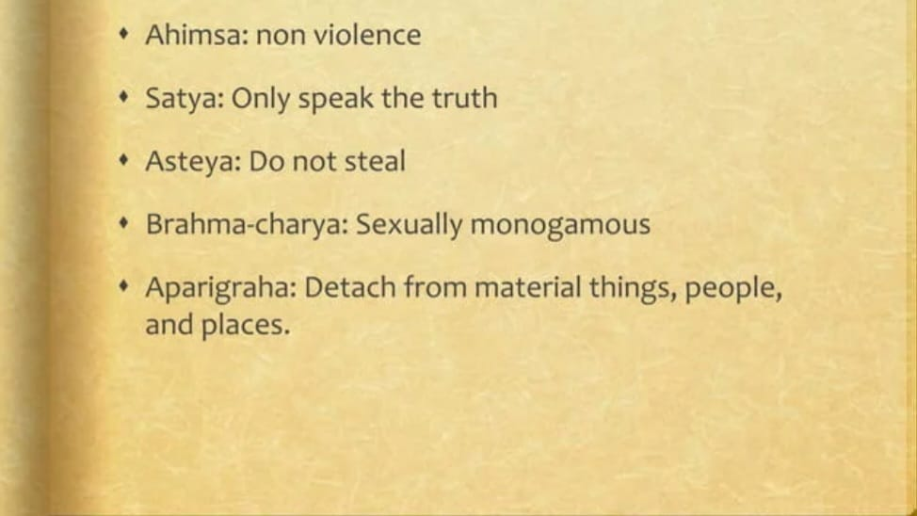
Five Principles of Living
(Vows)

Slide 8
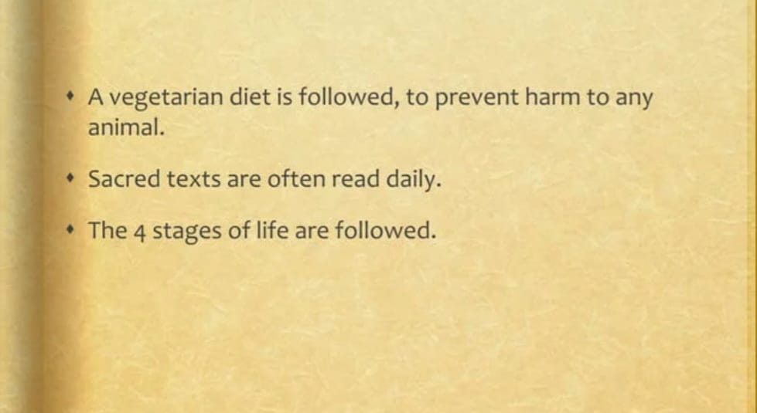
Basic Practices

Slide 9
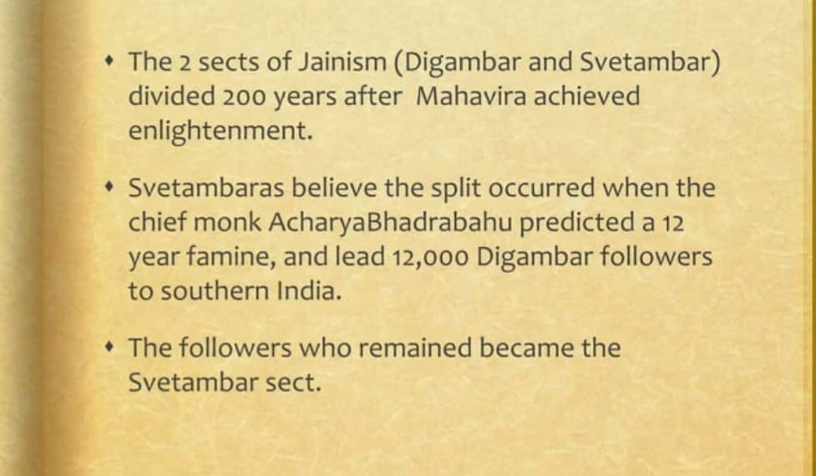
Organization of Jainism

Slide 10
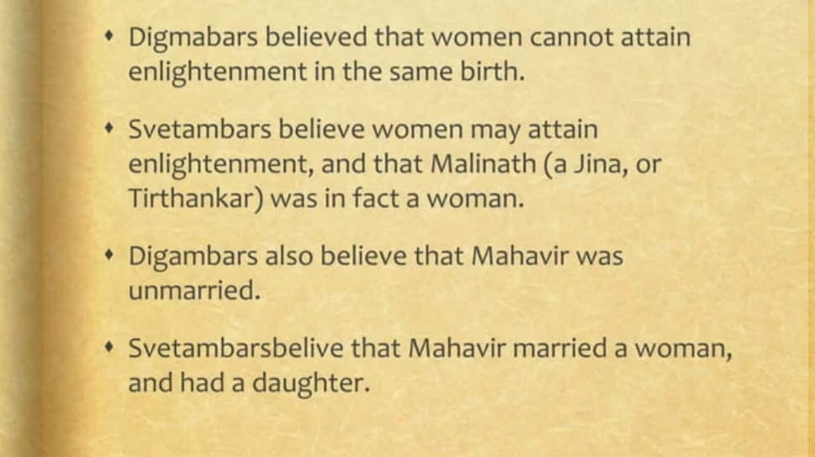
Difference between Digambar and Svetamber

Slide 11
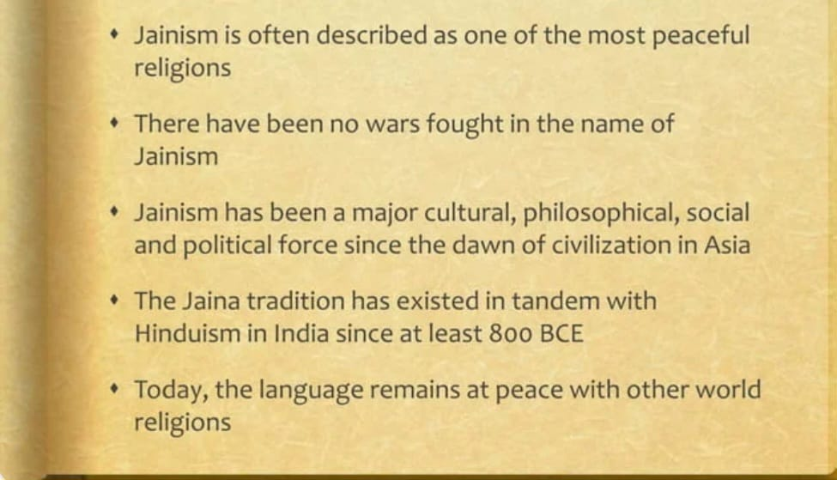
The Peaceful Nature of Jainism

Slide 12
Thank
you

